Slide 1
D3

Slide 2


Slide 3
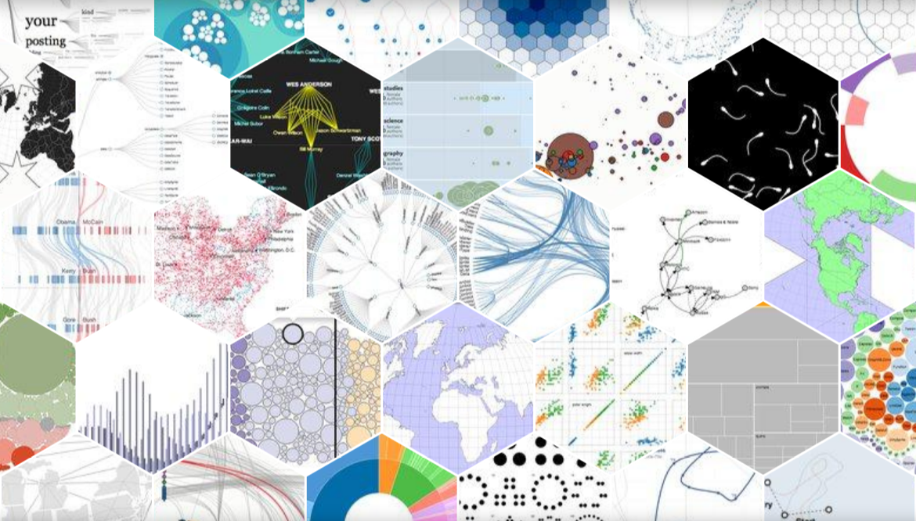

Slide 4
BACKGROUND
D3.js and Chart.js are popular JavaScript libraries for creating info graphics but D3.js can create more advanced graphics.
D3.js has 85k stars and Chart.js has 44k stars on github.
Infographics are often used to easily present data to the user.
D3.js lets you build similar elements to what is seen on excel charts.
The documentation can be found here https://d3js.org/.

Slide 5
IMPORTING
The preferred way to import is to use the npm install command.
Another way is to insert the JavaScript links(shown below) on the index.html file:
<script src="https://d3js.org/d3.v7.min.js"></script>

Slide 6
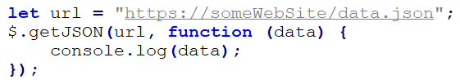
GET JSON
The first step of setting up a D3 graphic is to get the JSON data from the internet.
To do this, the url is required, and a .getJSON() callout, to run the request to the server.

Slide 7
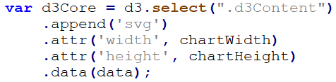
BIND D3
The 2nd step is to bind the D3 library to an HTML element, build the .svg canvas, and bind the JSON data imported from the url.
An example is shown below.

Slide 8
ADD ELEMENTS
On the d3Core variable defined in the previous slide, elements like grid lines, labels, and legends can be added to the chart, by using the .append() function.
For example, here is sample syntax to add a title to a chart:
d3Core.append('text').attr('x', 200).attr('y', 50).attr('id', 'fontChartTitle').text('Some Title');
Here is an example to add a legend:
d3Core.append('text').attr('x', 725).attr('y', 250).attr('id', 'fontChartLabel').text('Dope');
d3Core.append('text').attr('x', 715).attr('y', 400).attr('id', 'fontChartLabel').text('No Dope');
d3Core.append("circle").attr("class", "circleStyle").attr('cx', 750).attr('cy', 200).attr('r', circleDefaultRadius);
d3Core.append("circle").attr("class", "circleNoDope").attr('cx', 750).attr('cy', 350).attr('r', circleDefaultRadius);

Slide 9
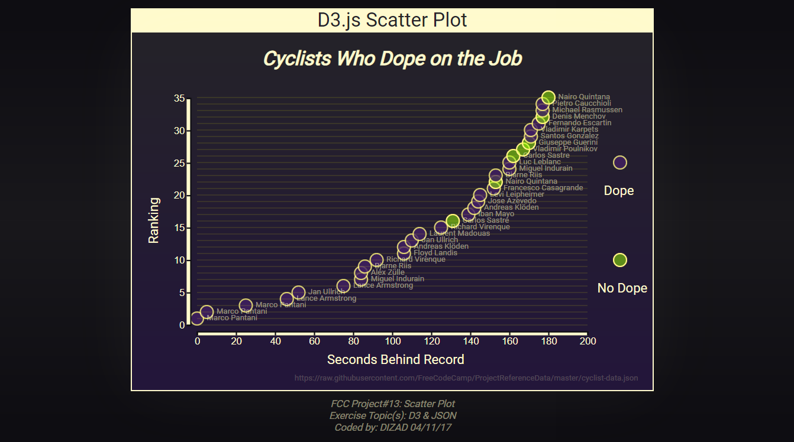

Slide 10
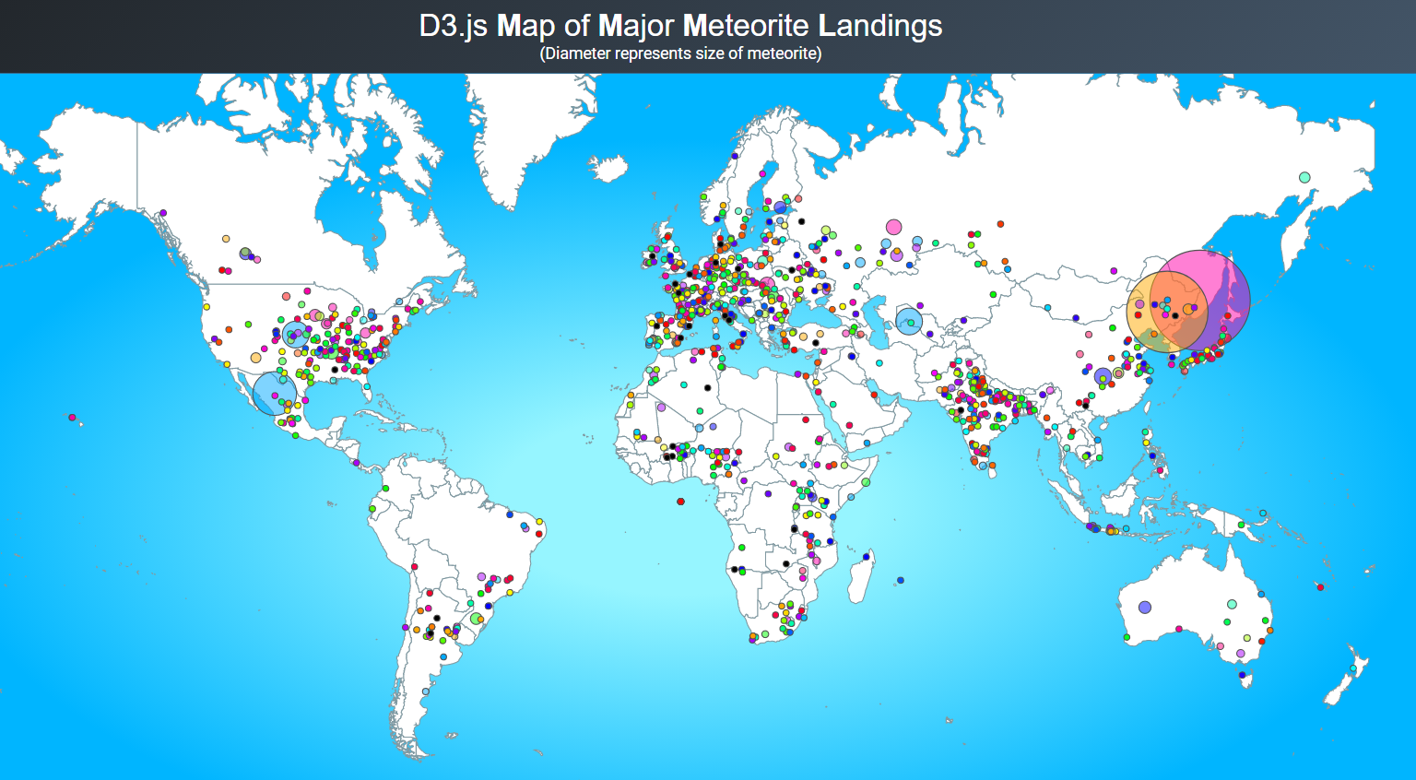

Slide 11
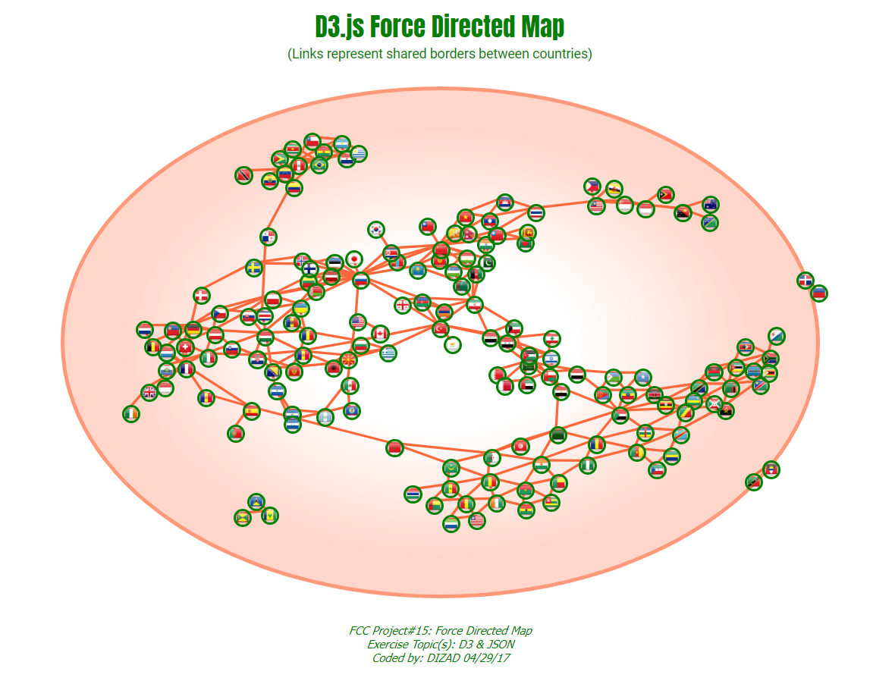

Slide 12
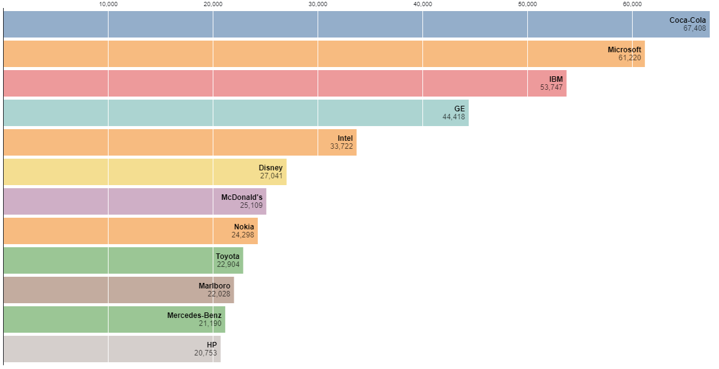

Slide 13
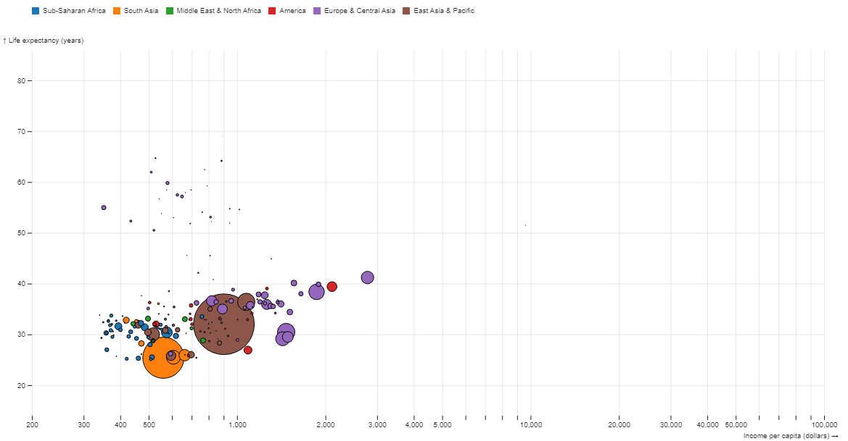

Slide 14
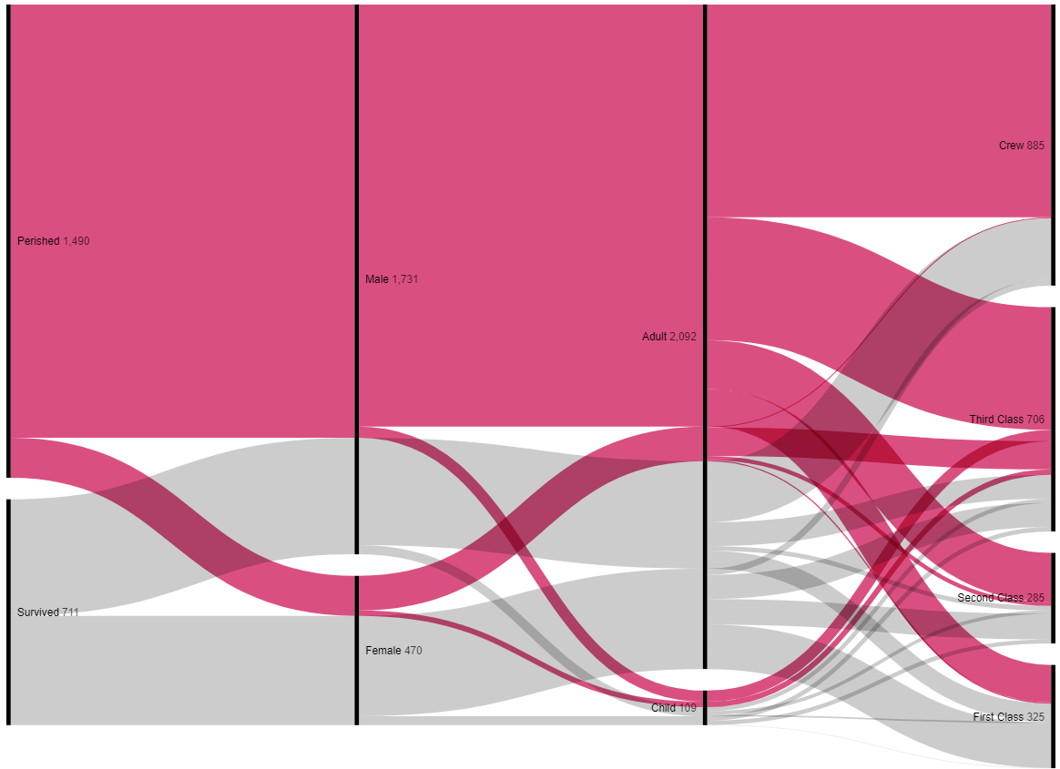

Slide 15
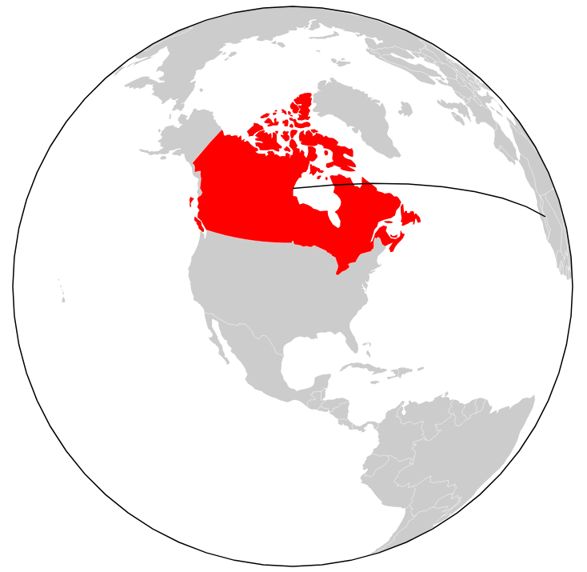

Slide 16
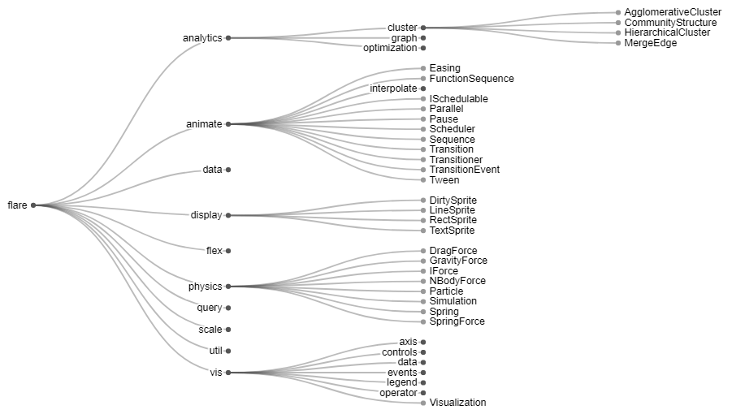

Slide 17
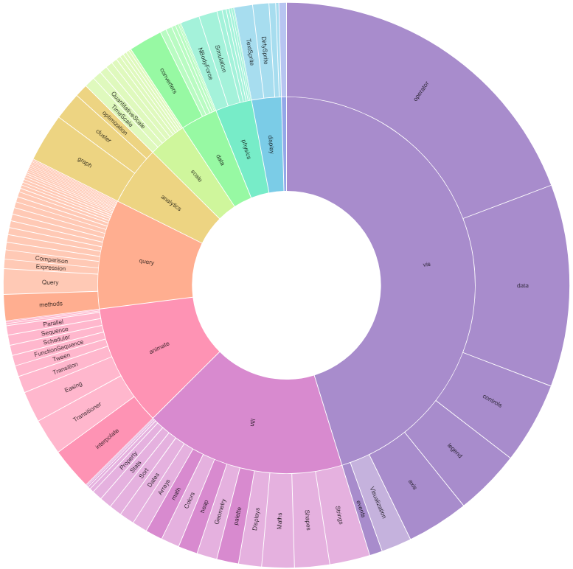

Slide 18
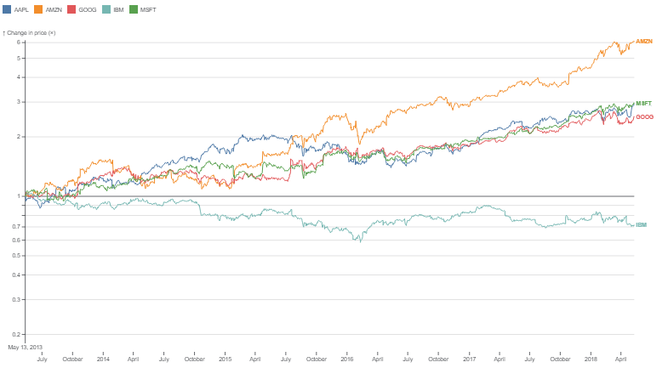

Slide 19
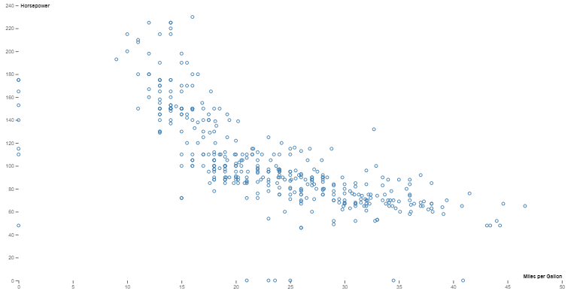

Slide 20
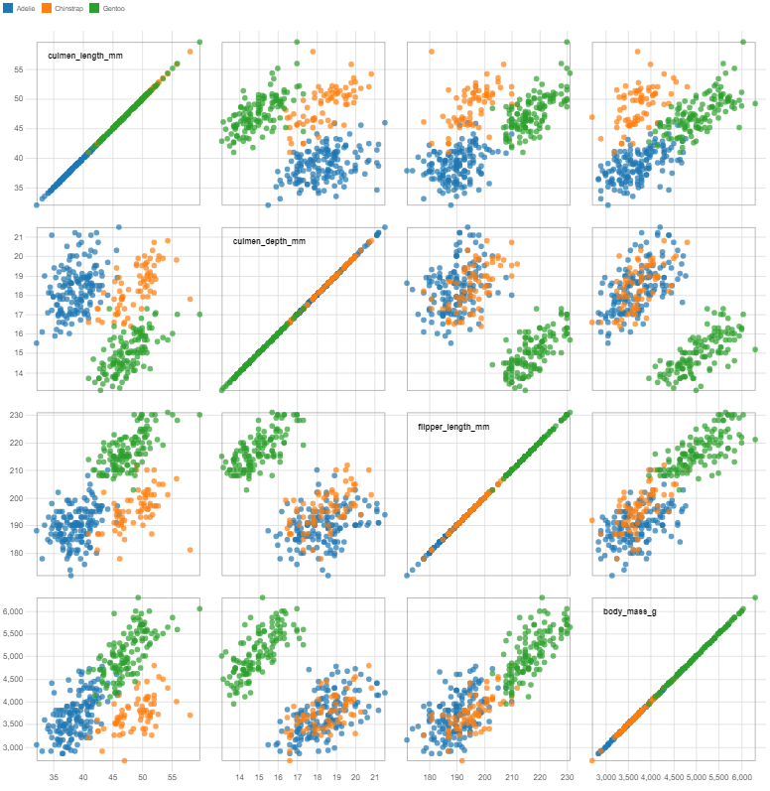

Slide 21
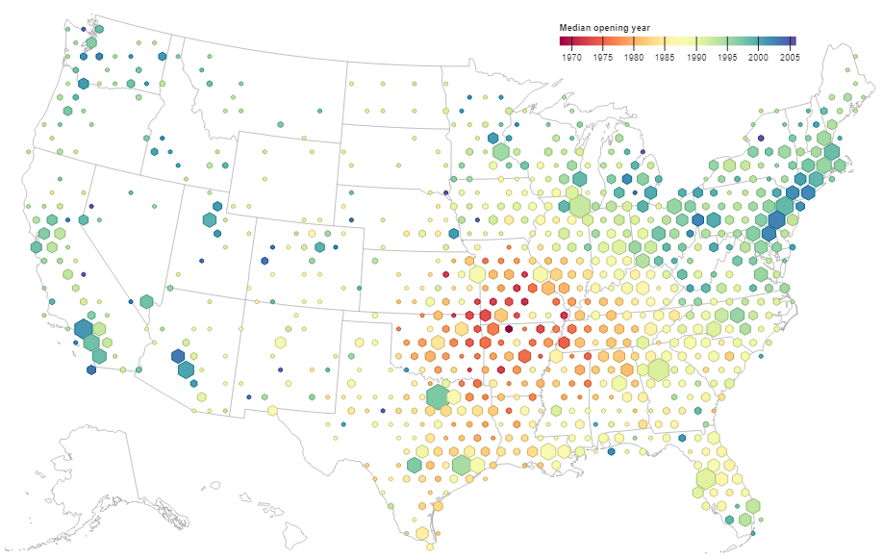

Slide 22
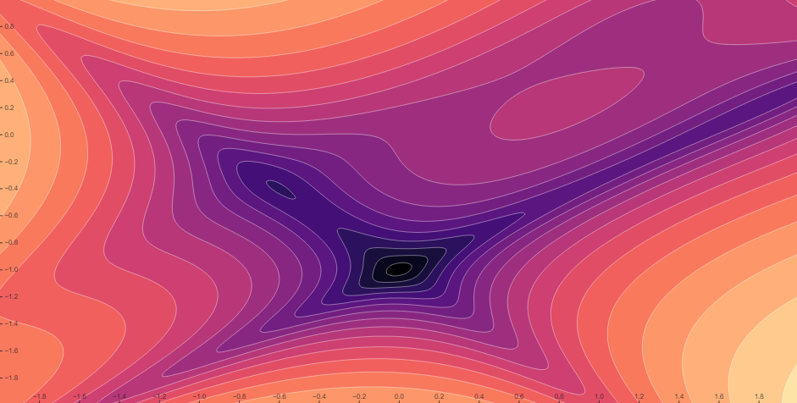

Slide 23
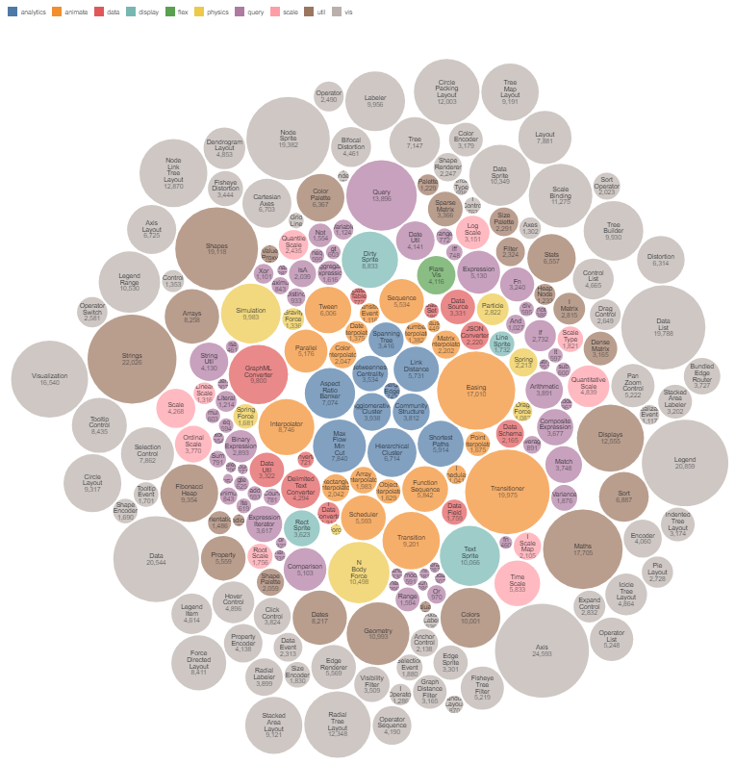

Slide 24
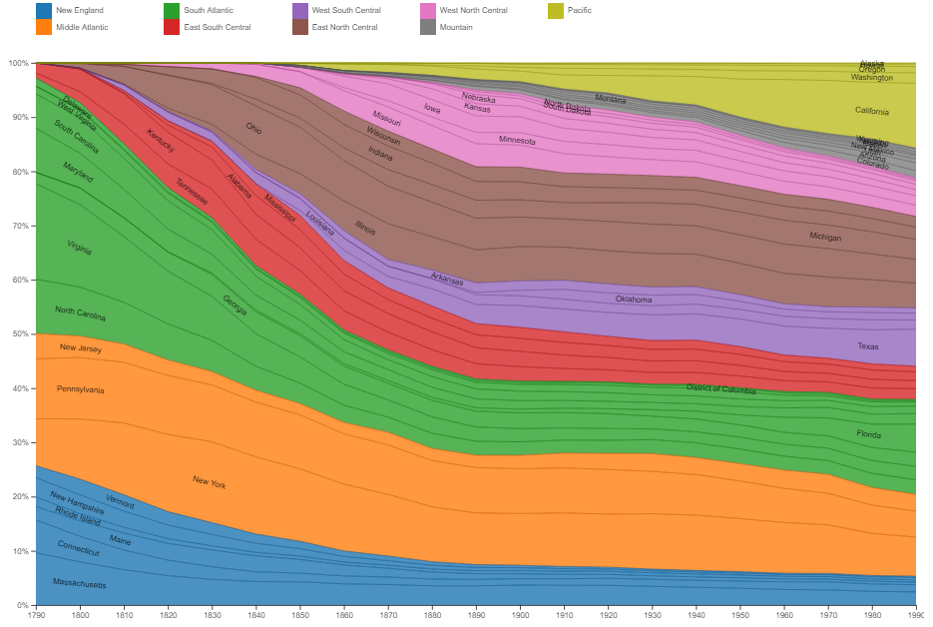

Slide 25
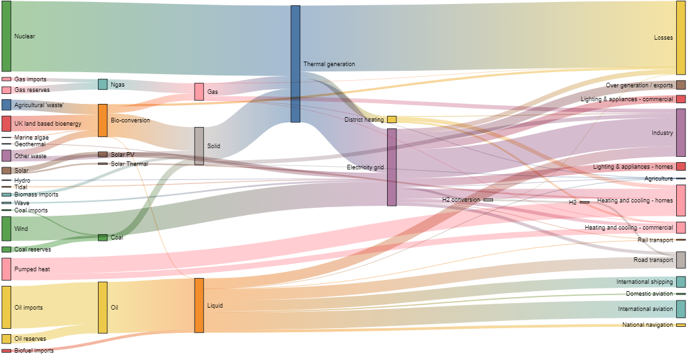

Slide 26
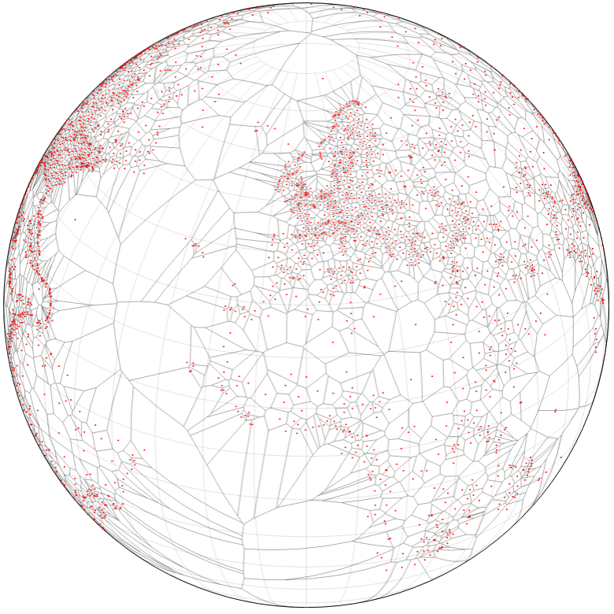

Slide 27
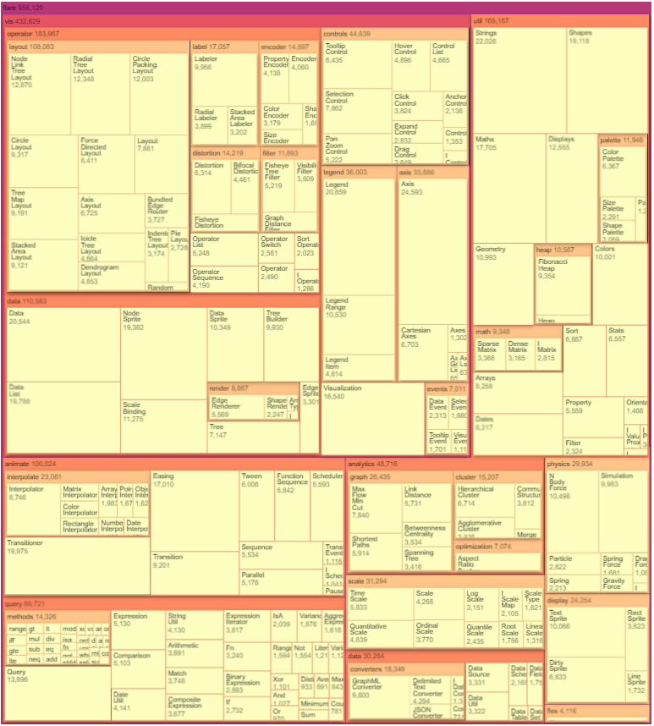

Slide 28
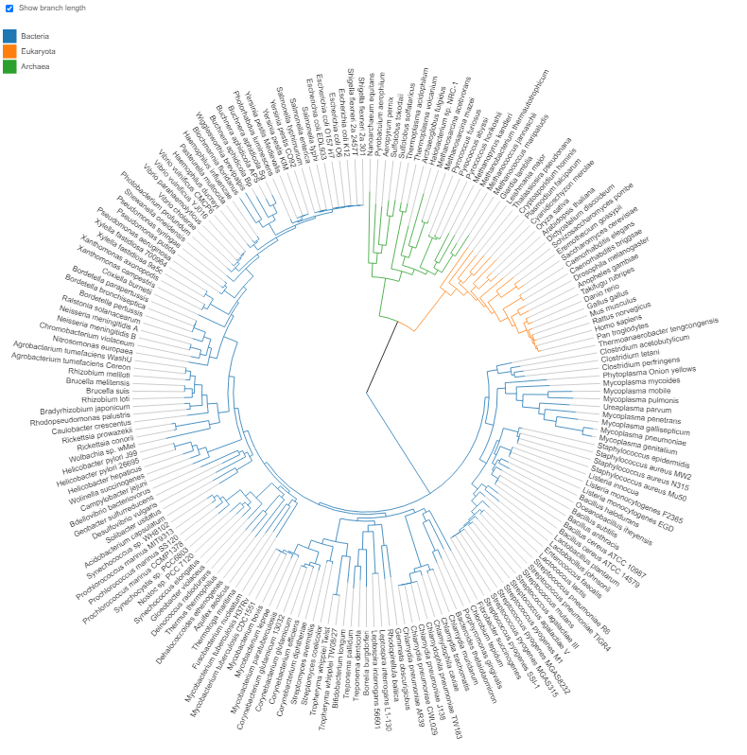

Slide 29
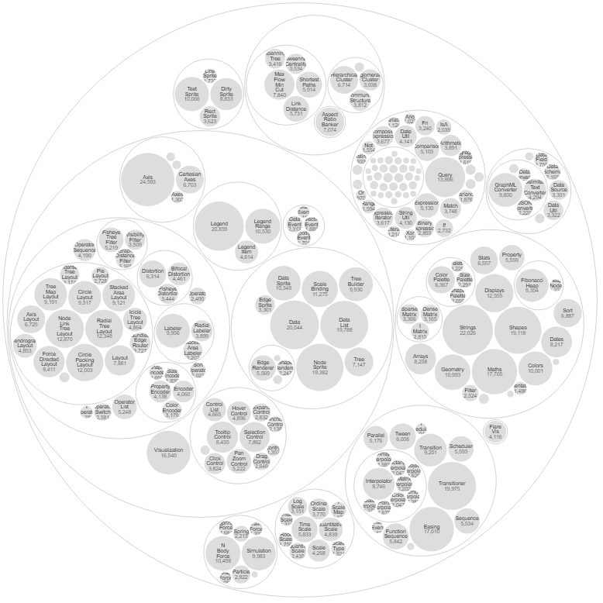

Slide 30
